Slide 1
Charan Parasuraman
FIFA WebPage
Web Programming

Slide 2
About the assignment
A web page about FIFA 2022 and a link to the personal info section.
The landing page has a animation when loaded or refreshed the elements starts to come in orde, with nice transition effects, the heading changes which is done by CSS.
The button present has a cool shining element with a control to navigate to the next section.

Slide 3
About the assignment
The top right corner is the menu icon which when clicked will transform into arrows and navbar will be displayed with some navigation Item which is been controlled using javascript.
The official emblem section has a Video with custom controls for the HTML file video elements and is controlled with the javascript.

Slide 4
About the assignment
Then the info section with a profile picture and project button which will lead to the Github page of the developer.
Finally the contact section with a dummy signup button and a footer with the name and copyright section.

Slide 5
Skills & expertise
User experience
Motion design
Physical Computing
Motion design
HTML, CSS,JS

Slide 6
assignment samples

Slide 7

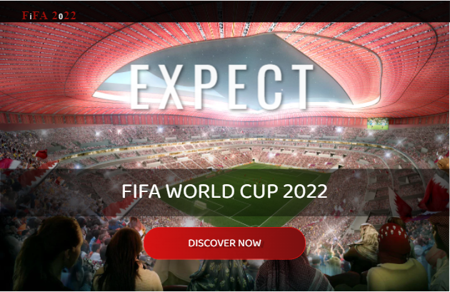
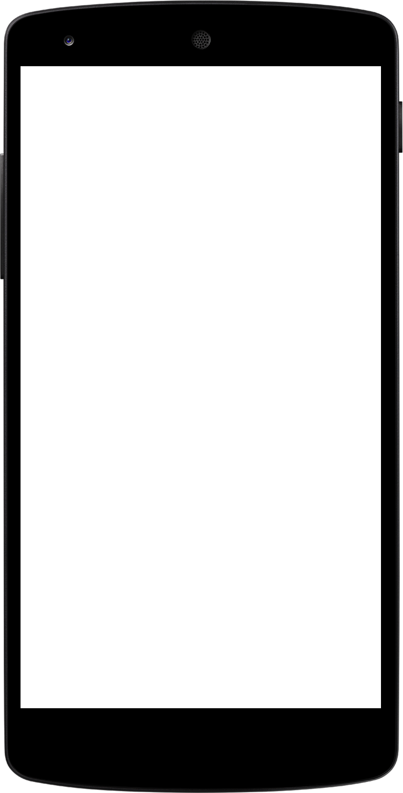
IDS 517 HW6
1. Create a Web page(s) to introduce about YOU.
2. Study HTML/5, CSS, and Javascript.
3. Use HTML/5, CSS, and javascript (must include all three).

Slide 8
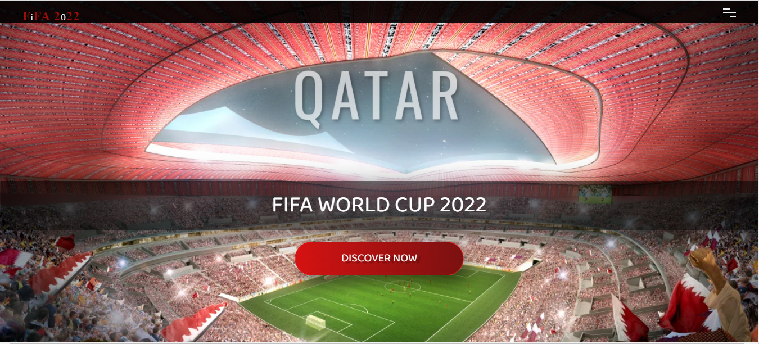
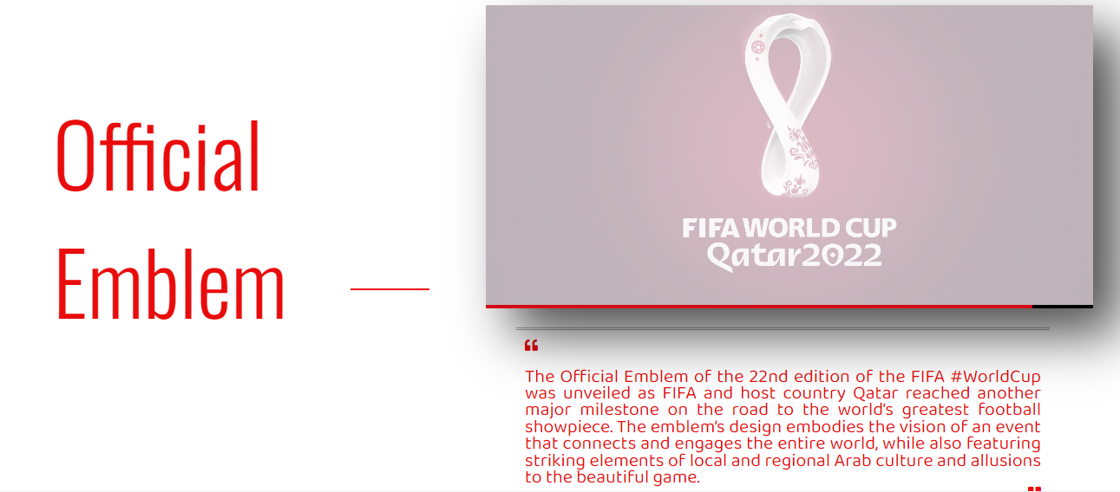

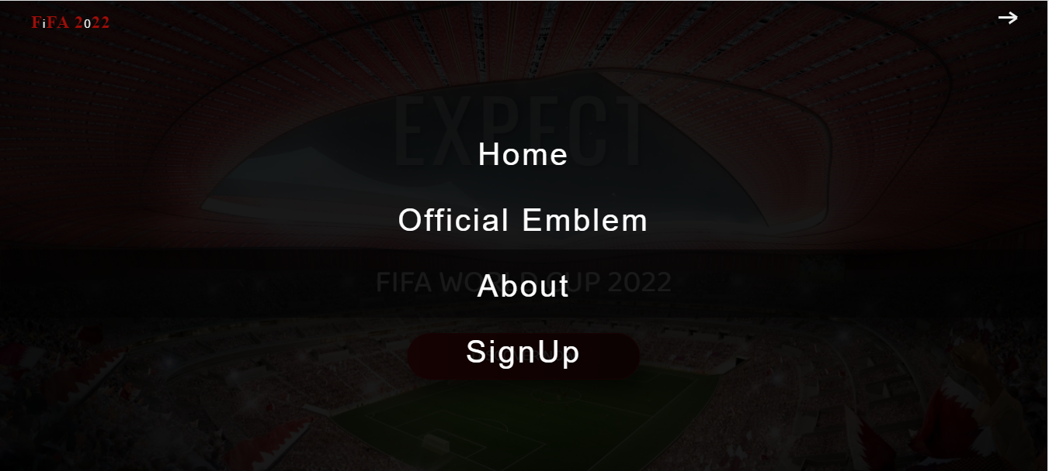
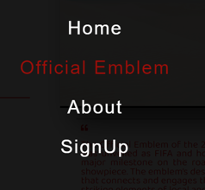
Landing Page
Official Emblem
The landing page has a animation when loaded or refreshed the elements starts to come in orde, with nice transition effects, the heading changes which is done by CSS.
The official emblem section has a Video with custom controls for the HTML file video elements and is controlled with the javascript.

Slide 9
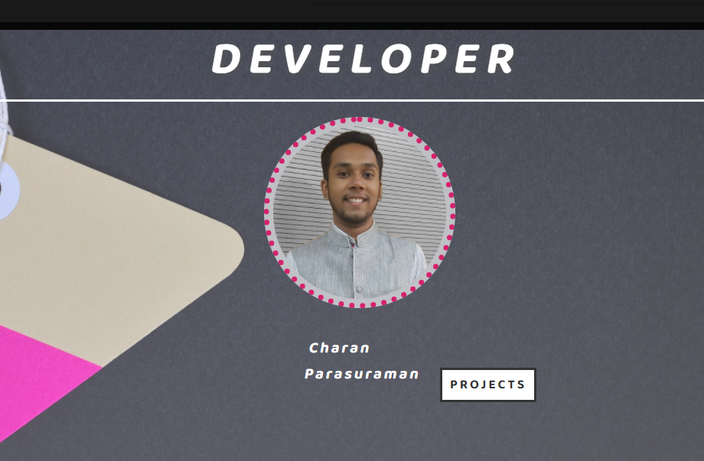
Web Page Developer
Charan Parasuraman
Project
Then the info section with a profile picture and project button which will lead to the Github page of the developer.
Designer
Student, UIC
April 10 2022

Slide 10
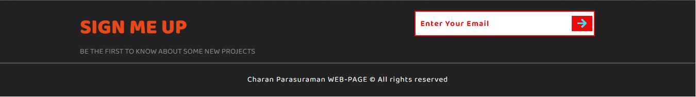
Contact
Your Name
no_reply@example.com
www.example.com
Finally the contact section with a dummy signup button and a footer with the name and copyright section.

Slide 11
HTML CODE
<!DOCTYPE html>
<html lang="en">
<head>
<meta charset="UTF-8">
<meta http-equiv="X-UA-Compatible" content="IE=edge">
<meta name="viewport" content="width=device-width, initial-scale=1.0">
<title>FIFA 2022</title>
<link rel="stylesheet" href="style.css">
<link rel="stylesheet" href="https://cdnjs.cloudflare.com/ajax/libs/font-awesome/5.15.1/css/all.min.css">
<link href="https://fonts.googleapis.com/css2?family=Baloo+Da+2:wght@400;500;600;700;800&family=Oswald:wght@200;300;400;500;600;700&display=swap" rel="stylesheet">
</head>
Title Page name and connection with the CSS as style.css
Used font-awesome and Oswal, link mentioned below.

Slide 12
HTML CODE
Navigation bar which spotted at the top, with right hand side of the page and with the title on the top left. Both the feature are responsive and will lead to the respective Home or the name present on the Nav list.
<!-- Navbar -->
<nav class="navbar">
<div class="navbar-logo">
<a href="#home">
<span>F</span>i<span>FA 2</span>0<span>22</span>
</a>
</div>
<div class="nav-list">
<a href="#home" class="nav-link">Home</a>
<a href="#Official Emblem" class="nav-link">Official Emblem</a>
<a href="#section-3" class="nav-link">About</a>
<!-- <a href="#" class="nav-link">Blog</a> -->
<a href="#section-4" class="nav-link">SignUp</a>
</div>
</nav>
<!-- End of Navbar -->
Each has its own function and navigated through the “href”

Slide 13
HTML CODE
<!-- Section 1 -->
<div class="container">
<section class="section-1" id="home">
<div class="banner">
<h1 class="banner-heading">
<span class="heading-1">Expect</span>
<span class="heading-2">Amazing</span>
<span class="heading-3">Qatar</span>
</h1>
<p class="banner-paragraph">FIFA World Cup 2022</p>
<a href="#Official Emblem">
<button class="banner-btn">Discover Now</button>
</a>
</div>
</section>
<!-- End of Section 1 -->
This is the main landing page of the code where one can find the initialization of the animated text on the web page. Which also consists of a banner paragraph and a button initiated with button class.

Slide 14
HTML CODE
<!-- Section 2 -->
<section class="section-2" id="Official Emblem">
<h1 class="section-heading"> Official Emblem</h1>
<div class="section-heading-line"></div>
<div class="video-wrapper">
<video src="images/FIFA World Cup Qatar 2022 _ Official Emblem-(1080p).mp4" class="video"></video>
<div class="controls">
<div class="video-bar-wrapper">
<div class="video-bar"></div>
</div>
<div class="buttons">
<button id="play-pause">
<i class="far fa-play-circle"></i>
</button>
</div>
</div>
</div>
Initiated with a tag of Official Emblem and linked with official emblem “ID” for the navigation using the nav-bar mentioned above
The next section or section 2 consist the path for the video shown on the web page and is linked with a video wrapper. And the video itself is linked with a play - pause button.

Slide 15
HTML CODE
<p class="section-2-paragraph">
<i class="fas fa-quote-left"></i>
The Official Emblem of the 22nd edition of the FIFA #WorldCup was unveiled
as FIFA and host country Qatar reached another major milestone on the road to the world’s
greatest football showpiece.
The emblem’s design embodies the vision of an event that connects and engages the entire world,
while also featuring striking elements of local and regional Arab culture and allusions to the beautiful game.
<i class="fas fa-quote-right"></i>
</p>
</section>
<!-- End of Section 2 -->
The section 2 ends with a paragraph <p></p> and enclosed on a quote left and a right class

Slide 16
HTML CODE
<!-- Section 3 -->
<section class="section-3 center" id="section-3">
<h1 class="section-3-heading">Developer</h1>
<img src="images/Parasuraman, Charan.jpg" alt="Charan" class="person-img" />
<h3 class="person-name">Charan Parasuraman</h3>
<a href="https://github.com/Charan-Parasuraman" target="https://github.com/Charan-Parasuraman" class="section-3-btn">Projects</a>
</section>
<!-- End of Section 3 -->
The Section 3 has a heading with a image of the developer and a button tag linked with the github page as which will be opened in a new tag defined as a “target”

Slide 17
HTML CODE
<!-- Section 4 -->
<section class="section-4" id="section-4">
<div class="section-4-text">
<h2 class="section-4-heading">Sign Me Up</h2>
<p class="section-4-paragraph">
BE THE FIRST TO KNOW ABOUT SOME NEW PROJECTS
</p>
</div>
<form class="signup-form ">
<input
type="email"
class="signup-form-input"
placeholder="Enter Your Email"
/>
<button type="submit" class="signup-form-btn">
<i class="fas fa-arrow-right"></i>
</button>
</form>
<p class="copyright">Charan Parasuraman WEB-PAGE &copy; All rights reserved</p>
</section>
<!-- End of Section 4 -->
Section 4 if the footer of the page and had a heading with a paragraph and linked with a dummy button and wrapped with text inside and a input specification of an email address and finally a paragraph ends with a copyright text.

Slide 18
CSS Code
/* Common Styles */
* {
margin: 0;
padding: 0;
box-sizing: border-box;
outline: none;
text-decoration: none;
list-style-type: none;
font-family: "Baloo Da 2", cursive;
}
html {
font-size: 62.5%;
scroll-behavior: smooth;
}
/* End of Common Styles */

Slide 19
CSS Code
More Explanation in the Code itself…

Slide 20
Js Code
// Navbar
const menu = document.querySelector(".menu");
const navbar = document.querySelector(".navbar");
menu.addEventListener("click", () => {
navbar.classList.toggle("change");
menu.classList.toggle('change')
});
// End of Navbar
Nave bar selector to add action listener as a Event click listener and to toggle to the menu options.

Slide 21
Js Code
// Section 2 Video
const video = document.querySelector('.video')
const btn = document.querySelector('.buttons button i');
const bar = document.querySelector('.video-bar')
const playPause = () => {
if(video.paused) {
video.play()
btn.className = 'far fa-pause-circle'
video.style.opacity = '.7'
} else {
video.pause()
btn.className = 'far fa-play-circle'
video.style.opacity = '.3'
}
}
btn.addEventListener('click', () => {
playPause()
})
Selecting a method in Js from the Video class of the HTML file, and implementing play pause option

Slide 22
Js Code
video.addEventListener('timeupdate', () => {
console.log(video.currentTime, video.duration)
const barWidth = video.currentTime / video.duration;
bar.style.width = `${barWidth * 100}%`
if(video.ended) {
btn.className = 'far fa-play-circle'
video.style.opacity = '.3'
}
})
// End of Section 2 Video
TO calculate the video time frame and to set the video duration bar and set visible using css.

Slide 23
WHAT CAN BE DONE?
Make Project responsive
As the current web page is optimized for and is built for large screen size.
Setting resolution of each aspect for the screen
Dynamic approach as to implement live chronograph features
Multiple design aspects

Slide 24
Thank You

